Slide 1
Target Market
Audio Enthusiast
Public Space Designers
They seek convenience and superior sound quality, combining traditional hi-fi equipment with modern digital streaming technology to enjoy their favorite music.
Professionals in medical, beauty, and wellness settings seek music that creates a soothing and welcoming atmosphere for visitors.
Content Creators
Mood Wellness Seekers
YouTubers, podcasters, and social media influencers
Game Developers
Market Professionals
Teachers and instructional designers
Individuals looking for calming music to improve their well-being, including those dealing with stress, anxiety, restlessness, or insomnia.

Slide 2
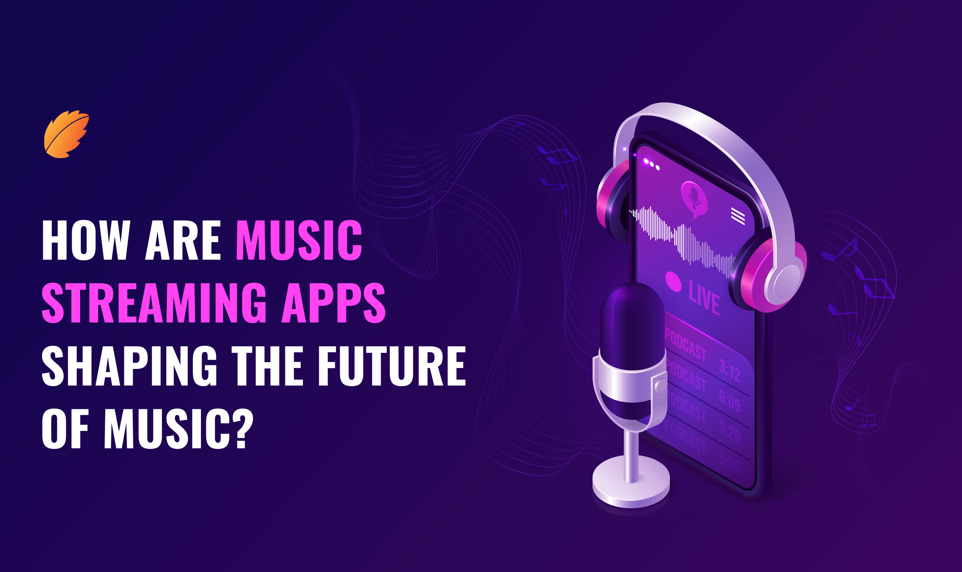
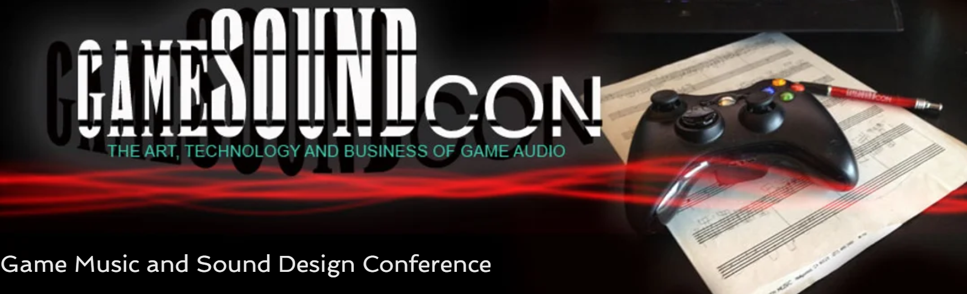

Streaming Music
Diversity
Personalization
Makes sharing easy
Why it’s worth it
Music therapy is an evidence-based practice using music interventions to address individual needs and improve well-being.
Music is a crucial element in creating an immersive gaming experience, enhancing the atmosphere, setting the mood, and adding depth. The value a composer brings to a game or film is always high.

Slide 3
The global music streaming market is projected to reach a revenue of 29.60 billion in 2024. With an expected annual growth rate (CAGR) of 4.70% from 2024 to 2027, the market is anticipated to grow to 33.97 billion by 2027.
Market Analysis
The global background music market, valued at $1.7 billion in 2023, is projected to grow to $2.7 billion by 2032, with a CAGR of 5.3%, highlights the substantial potential for growth, driven by the expanding media and entertainment industry and the rising popularity of cost-effective digital music subscriptions among younger audiences. (https://www.imarcgroup.com/background-music-market )
The sound therapy market is valued at $1.12 billion in 2023, and expected to grow to $2.26 billion by 2032, with a CAGR of 8.1%. (https://introspectivemarketresearch.com/reports/sound-therapy-market/ )
In larger game development budgets, voice acting is a significant component. For example, in the development of the game Star Wars: The Old Republic, which had a total estimated budget of around $200 million, a large portion was allocated to voice acting. (https://kevurugames.com/blog/how-much-does-it-cost-to-make-a-video-game-clear-formula-and-the-highest-grossing-genres-in-2023/)
The combined market value across music streaming, background music, sound therapy, and game development budgets are projected to exceed $34.76 billion, highlighting immense growth potential.

